Slide 1

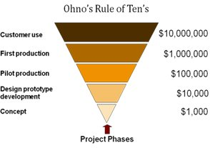
Internal customer-supplier relationships …
aim for a 100% quality
Increase employee motivation through autonomy increase
create responsibility delegation
reduce costs through external controls
enable small, agile control circuits
10s rule of error costs
Experience rule from the quality management that the costs of error prevention and error correction in each phase by a factor of 10 increase: if errors are not avoided in planning and development, but only in the design of work steps and process (work preparation , Process organization) or even in production, final inspection or even at the customer - then they are 1,000 times higher than the costs of error prevention in planning and development.
0-Defect
Principle
85% of all errors are systemic
Seperate the problem from the person
Zero error principle must become standard
Process n-1
ist Supplier for
is customer from
Process n
is customer from
is supplier for
Process n+1
5
6
1

Slide 2

Zero-defect production means ...
There is no acceptable level of error
Every mistake is tracked and the causes fought
The achievement of quality has absolute priority before reaching the quantity
Every employee
is entitled and obliged to stop the production in the event of an irregularity (material, machine or product)!
The zero-error principle is an aspiration of all parties to reduce the error rate to zero. This includes all measures and precautions that make processes and instructions safe, comprehensible and controllable.
One of the principles is Poka Yoke.
It comes from Japanese and means "avoid accidental wrongdoing" or "foolproof".
It describes a system consisting of several components, which contains technical measures or devices for the immediate detection and avoidance of errors.
Stop !
1. Detecting the error in the process
by IPC (In Process Control)
2. Stop the system
3. Determine cause
4. Initiate provisional measures
e.g. Change wearing parts,
100% testing of products or
Material at temporary testing station
5. Restart the system
6. Systematic problem solving by
PDCA, 6M or 8D
Stable processes are the basis for short lead times and high productivity.
Tolerate and "pray healthy"
Run the system and sort out missing parts
2
3
4

